Slide 1
2022 Annual Report for Online Education
Dr. Jon Rogers, Assistant Vice Chancellor June 22, 2023
www.flbog.edu

Slide 2
Participation in Online Education
Percentage of SUS undergraduate students enrolling in one or more online courses each year
Percentage of SUS graduate students enrolling in one or more online courses in the fall term
Percent of undergraduate FTE in online courses
Percent of graduate FTE in online courses
Goal 2025: 80%
Goal 2025: 60%
Goal 2025: 35%
Goal 2025: 34%

Slide 3
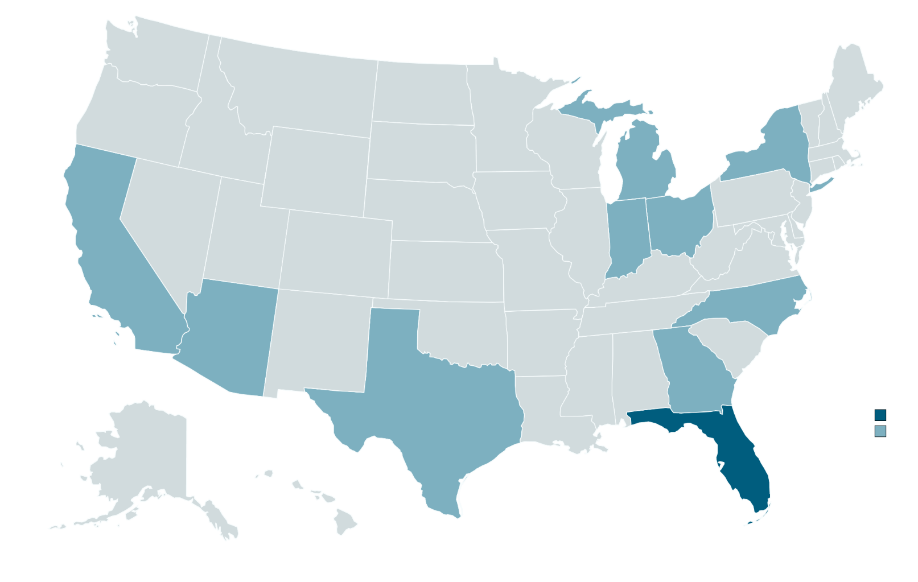
Top 10 States for Distance Learning Enrollments
1
California
2
Texas
3
New York
4
Florida
5
Ohio
6
Georgia
7
Michigan
8
North Carolina
9
Indiana
10
Arizona
*See Figure 1

Slide 4
Online Majors in Programs of Strategic Emphasis
DEGREE LEVEL | STEM | EDUCATION | GAP ANALYSIS | GLOBAL | HEALTH | TOTAL
Bachelors | 24 | 8 | 9 | 10 | 28 | 79
Masters | 112 | 48 | 11 | 8 | 50 | 229
Professional Doctorate | 0 | 1 | 0 | 0 | 10 | 11
Research Doctorate | 4 | 3 | 0 | 0 | 3 | 10
Specialist | 1 | 2 | 0 | 0 | 0 | 3
Total | 141 | 62 | 20 | 18 | 91 | 332

Slide 5
US News & World Report: National Rankings Best Online Bachelor’s Degree Programs
#1
#42
University of West Florida
UF Online
#8
University of Central Florida
#60
Florida International University
#39
University of North Florida
#65
Florida Atlantic University

Slide 6
Presidents Award: Outstanding Online Teaching
FAU
Dr. Anna Agapova
UF Online
Dr. Crystal Marull
UWF
Dr. Andrea Nelson
UNF
Dr. Nilufer Ozdemir
USF
Dr. Sanghoon Park
FGCU
Dr. Tammy Sadighi
UCF
Dr. Michael Strawser
FIU
Dr. Melody Willoughby

Slide 7
Outstanding Online Students in the SUS
Justin Green
Pierre Boucard
Manny Zavala
Sean Rowe
Irene Varela
Rachel Davis
Juanita Martinez
Robin Brandenburg

Slide 8
Percent of Grades in Undergraduate Courses by Delivery Method
DELIVERY METHOD | FALL 2020 |  |  | FALL 2021
 | A/B/C/S | D/F/W/U | TOTAL | A/B/C/S | D/F/W/U | TOTAL
ALL DISTANCE & PRIMARILY DISTANCE | 90% | 10% | 100% | 89% | 11% | 100%
HYBRID | 91% | 9% | 100% | 89% | 11% | 100%
CLASSROOM | 91% | 9% | 100% | 89% | 11% | 100%
FLEX | 84% | 16% | 100% | 91% | 9% | 100%
TOTAL | 90% | 10% | 100% | 89% | 11% | 100%

Slide 9
Median Years to Degree for Full-Time FTIC Undergraduates in 120 Hr. Programs
 | 2020-21 | 2021-22
% DL | MEDIAN | MEDIAN
0% | 4.92 | 3.75
1-20% | 4.33 | 4.33
21-40% | 3.75 | 3.92
41-60% | 3.75 | 3.75
61-80% | 3.75 | 3.67
81-99% | 3.33 | 3.00
100% | 3.50 | 2.75
TOTAL | 3.75 | 3.75

Slide 10
Percent of Undergraduates Enrolled After One Year by Delivery Method

Slide 11
Online Program Delivery: INNOVATIONS
A Science Lab Immersive Online Content Program
Use of PlayPosit Interactive Video Technology
Employment of Student Success Advisors
Gator Pathways program as a digital hub & entry point for all students; The Gator Pathways College Network online consortium with state college partners in the region
A Digital Wellness Portal for online students for student support services

Slide 12
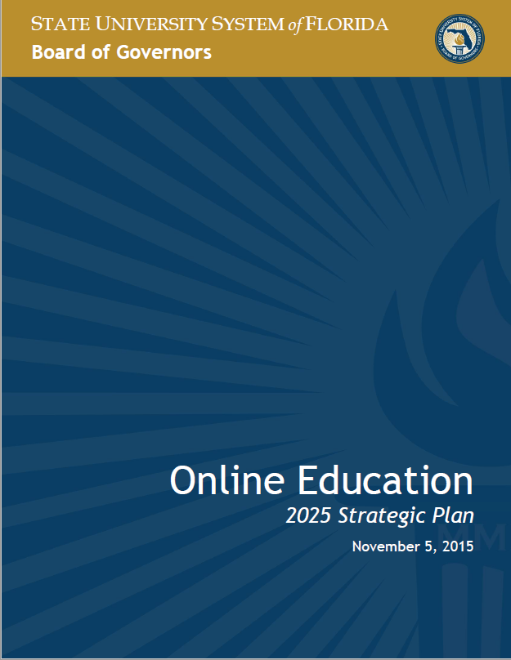
2025 Strategic Plan for Online Education

Slide 13
www.flbog.edu

